Slide 1

Goal pro Project
WIL Presentation

Slide 2
Group 1 Members
Jarrod Singh 16003776
Wade Buckthorp 17001922
Sachin Bridgemohan 17046151
Joseph Nqojane 17395801
Theasan Naidoo 16002917

Slide 3


Our approach

Slide 4





Our applications
Android
App
API
Database
Web
app
Future Development

Slide 5


Costing & hosting
Costing
Hosting

Slide 6

Public website

Slide 7
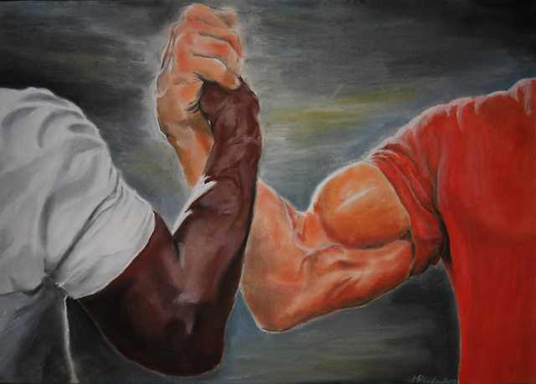
Private website
Android
App
Private
Website

Slide 8


Game & leaderboard
Game
Leader Board

Slide 9

Future ideas
Events
Page

